Slide 1
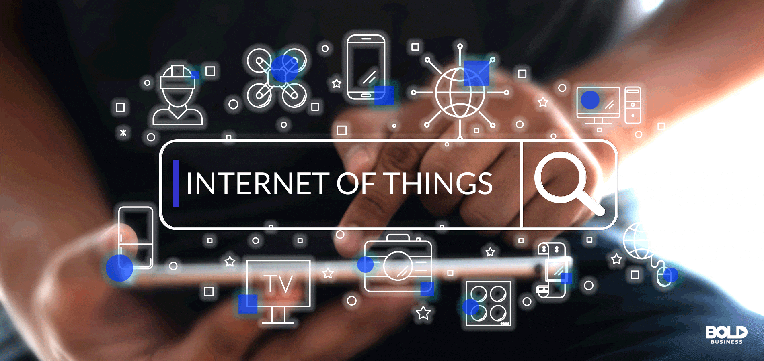

Slide 2

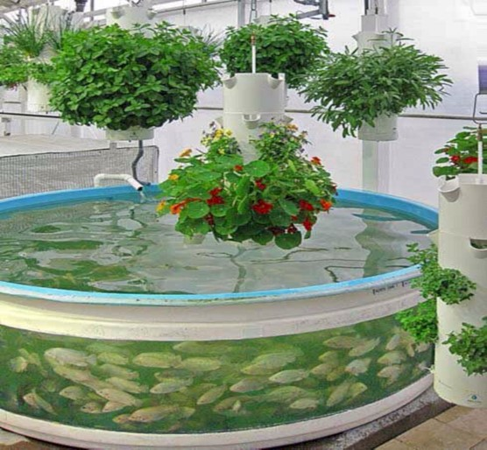
perseverance
Nutrient Management System
Develop a system that monitors nutrient levels in hydroponic
systems and displays data on an LED , with alerts for imbalances

Slide 3
perseverance
01
IoT concepts and the project's purpose
Table
of contents
02
Research on IoT technologies
03
Scope and objectives of the project
04
Project requirements
04
prototypes and
implement

Slide 4
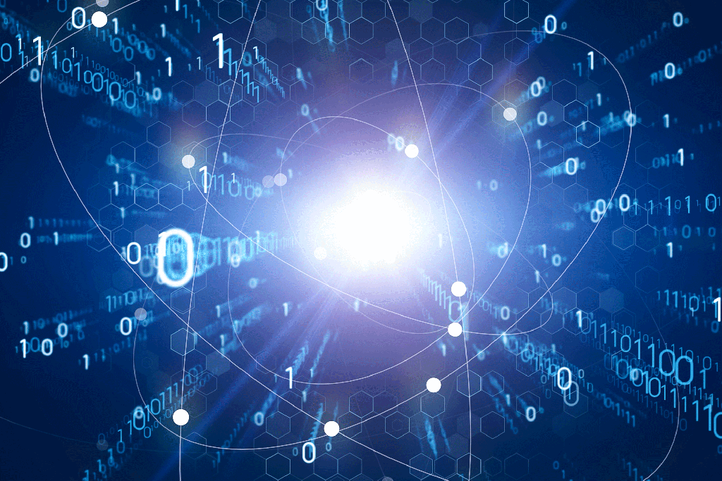
01
IoT concepts and the project's purpose

Slide 5
“IoT, or the Internet of Things, refers to a network of physical objects or "things" embedded with sensors, actuators, software, and connectivity capabilities that enable them to collect and exchange data with other devices and systems over the internet.
Project's Purpose
Objectives 1
Objectives 2
Objectives 3
Presentation are communication tools that can be used as demontrations, lectures, reports, and more.
Presentation are communication tools that can be used as demontrations, lectures, reports, and more.
Presentation are communication tools that can be used as demontrations, lectures, reports, and more.
Hydroponics is a method of growing plants without soil, where nutrient-rich water is used as the medium for plant growth. In such systems

Slide 6
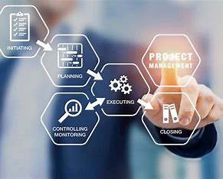
it is critical to maintain the optimal balance of nutrients in the water to
ensure healthy plant growth and maximize yields.
Optimizing Nutrient Levels
Preventing Nutrient Imbalances
Remote Monitoring and Control
Improving Efficiency and Sustainability
Enhancing Crop Management

Slide 7
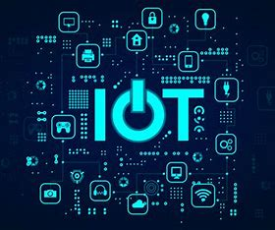
02
Research on IoT Technologies

Slide 8

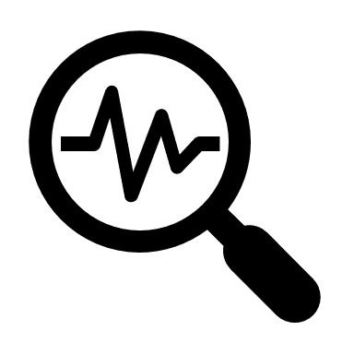

IoT Technologies
Sensors
Microcontrollers
Communication Protocols

Slide 9


Communication Protocols
IoT device communicate
with each other and with cloud-based platforms using various communication protocols.
MQTT
1
(Message Queuing Telemetry Transport)
2
HTTP
3
CoAP
(Hypertext Transfer Protocol)
(Constrained Application Protocol),

Slide 10
Potential Applications
Precision Agriculture
Automated Irrigation Systems
Smart Greenhouse Management
Crop Monitoring and Disease Detection

Slide 11
03
Scope and
objectives of
the project

Slide 12



Scope of the Nutrient Management System Project
The Nutrient Management System (NMS) aims to monitor and manage nutrient levels in hydroponic systems, specifically targeting various types of hydroponic setups such as Deep Water Culture (DWC), Nutrient Film Technique (NFT), and Ebb and Flow systems. The system will focus on monitoring essential nutrients required for plant growth, including nitrogen, phosphorus, potassium, calcium, magnesium, and trace elements.

Slide 13
Objectives of the Project
Accurate Nutrient Monitoring
Real-time Data Collection and Analysis
Alert System for Nutrient Imbalances
LCD Display for Data Visualization
User Interface and Interaction

Slide 14
04
Project requirements

Slide 15
Components
Micro
controller
Sensors
EC Sensor
Temperature Sensor
pH Sensor
Arduino
Raspberry Pi

Slide 16

Prototype Development and IoT Device
Communication
Software Implementation
2
1
3
Hardware Setup
IoT Device Communication

Slide 17
Prototype Development and IoT Device
Communication
5
4
Testing and Validation
Documentation and Troubleshooting

Slide 18
THANK YOU

